Slide 1
Automated Skin Disease Classification using Deep Learning Enhancing Diagnostic Accuracy and Patient Care
Oluwole Ajakaye
May 2024

Slide 2
Overview of the Project
Objective: "To develop an accurate and automated system for classifying skin diseases from facial images using deep learning techniques.“
The dataset is classified as acne, redness, and bags which are total of 90 images.

Slide 3
Importance of the project in the context of dermatology and patient care.
Importance in Dermatology
Enhanced Diagnostic Accuracy:
Automated skin disease classification aids in identifying conditions that may be difficult to diagnose visually.
Reduces the likelihood of human error, ensuring more accurate and reliable diagnoses.
Efficient Use of Dermatologists’ Time:
Automates initial screening processes, allowing dermatologists to focus on complex cases.
Speeds up the diagnostic process, leading to quicker treatment initiation.
Access to Dermatological Expertise:
Provides dermatological assessments in areas with limited access to specialists.
Facilitates remote consultations, making expertise available to a broader population.
Consistent and Objective Diagnoses:
Ensures standardized evaluations free from subjective bias.
Supports dermatologists with consistent second opinions, improving diagnostic confidence.

Slide 4
Importance of the project in the context of dermatology and patient care.
Importance in Patient Care
Early Detection and Treatment:
Identifies skin conditions at an early stage, allowing for timely intervention.
Prevents disease progression, reducing the risk of complications.
Personalized Treatment Plans:
Enables the customization of treatment based on accurate diagnosis.
Supports personalized skincare recommendations, improving patient outcomes.
Improved Patient Engagement:
Empowers patients with knowledge about their skin condition.
Enhances patient adherence to treatment plans through better understanding and awareness.
Cost-Effective Healthcare:
Reduces the need for multiple consultations and unnecessary treatments.
Lowers overall healthcare costs by streamlining the diagnostic process.
Education and Awareness:
Raises awareness about skin health and disease prevention.
Educates patients on the importance of dermatological care, promoting proactive health management.

Slide 5
Methodology
Dataset Overview:
Our dataset consists of facial images categorized into three skin disease classes: acne, redness, and bags.
Images are collected from various sources to ensure diversity and represent different skin tones and conditions.
Data Augmentation Techniques:
To address the issue of limited data, we employ data augmentation techniques.
Rescaling: Normalize pixel values to a range of [0, 1] by rescaling with a factor of 1/255.
Rotation Range: Randomly rotate images within a range of 20 degrees to introduce rotational variance.
Width and Height Shifts: Shift images horizontally and vertically by 20% to make the model invariant to small translations.
Shear Range: Apply shear transformations with a shear range of 0.2 to simulate a 3D perspective effect.
Zoom Range: Randomly zoom into images by 20% to make the model robust to different scales.
Horizontal Flip: Randomly flip images horizontally to augment the dataset and simulate real-world conditions.

Slide 6
Methodology
Validation Split:
The dataset is split into 80% training and 20% validation sets to evaluate model performance.
Detailed Architecture of the Deep Learning Model
1. Convolutional Neural Network (CNN) Layers:
Our model is based on a Convolutional Neural Network (CNN) architecture designed for image classification tasks."
Input Layer: "Accepts input images of size 150x150 with 3 color channels (RGB).
Conv2D Layers: Four convolutional layers with 32, 64, 128, and 128 filters respectively, using ReLU activation to capture spatial features.
MaxPooling Layers: Four max-pooling layers to reduce the spatial dimensions and retain essential features.
2. Fully Connected (Dense) Layers:
A Flatten layer to convert the 3D feature maps to 1D feature vectors.
A Dense layer with 512 neurons and ReLU activation, with L2 regularization to prevent overfitting.
A Dropout layer with a rate of 0.5 to further prevent overfitting by randomly setting half of the neurons to zero during training.
3. Output Layer:
A Dense layer with 'softmax' activation to output probabilities for each of the three classes (acne, redness, bags).

Slide 7
Methodology
Training Process and the Role of Class Weights
Training the Model
1. Training Process:
The model is compiled using the Adam optimizer, which is efficient for large datasets and requires minimal tuning.
Loss Function: 'Categorical Crossentropy' is used as it is suitable for multi-class classification problems.
Metrics: 'Accuracy' is tracked to monitor the performance of the model.
2. Handling Class Imbalance:
Class weights are computed to address the imbalance in the dataset where some classes have fewer samples than others.
Class Weights Calculation:
Class weights are calculated using the compute_class_weight function from sklearn to ensure that each class contributes equally to the loss during training.
This helps the model not to be biased towards the majority class.
3. Callbacks for Efficient Training:
EarlyStopping: Monitors the validation loss and stops training if it does not improve for 5 consecutive epochs, preventing overfitting.
ModelCheckpoint: Saves the best model based on validation loss during training to ensure we retain the most effective model.
By following this methodology, we aimed to develop a robust model capable of accurately classifying skin diseases from facial images, even with a limited dataset.

Slide 8
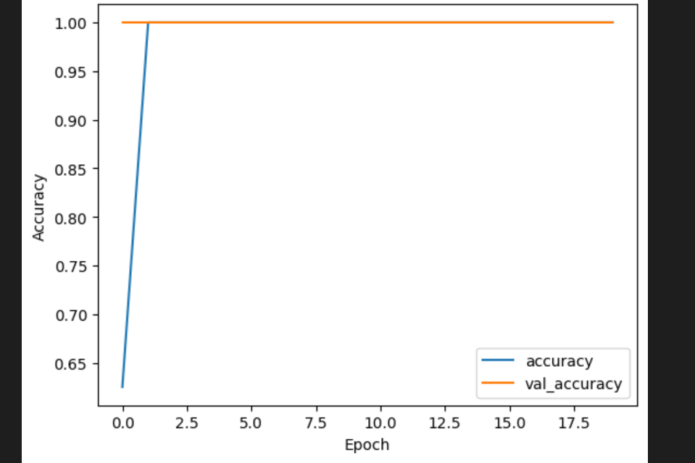
Results

Slide 9
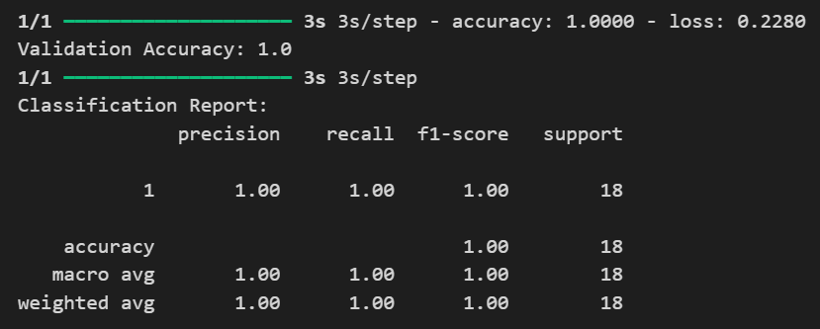
Results

Slide 10
Results
The output displayed in the diagrams above shows the model is performing well, achieving 100% accuracy on both the training and validation sets. The classification report also indicates perfect precision, recall, and F1-score for the single class in your dataset.
In the graph showing training history, both the accuracy and validation accuracy are above 0.90 for most of the epochs, which is a good sign. However, the validation accuracy appears to be slightly lower than the training accuracy throughout, which could be a sign of slight overfitting.

Slide 11
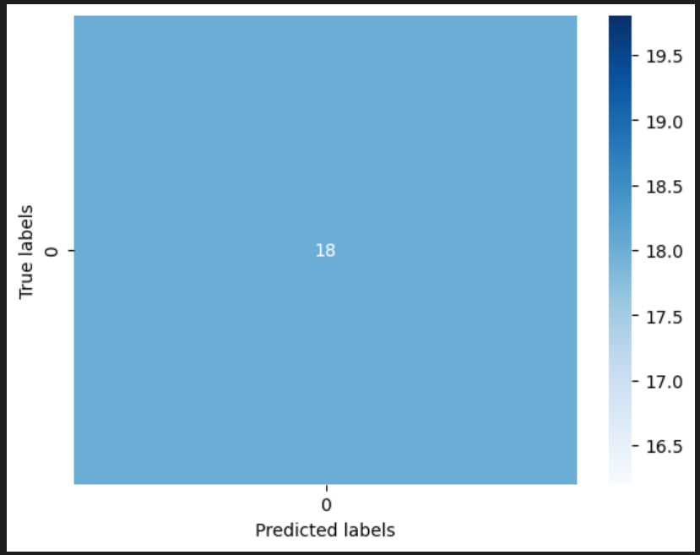
Results

Slide 12
Results
From the scatter plot, where the x-axis represents the number of predicted labels and the y-axis represents the number of true labels. Ideally, the data points would all fall on a diagonal line from the bottom left corner to the top right corner. This would indicate that the model is perfectly predicting the number of true labels. In this scatter plot, there are data points that are above and below the diagonal line. This means that the model is sometimes over-predicting the number of labels (predicting more labels than are actually there) and sometimes under-predicting the number of labels

Slide 13
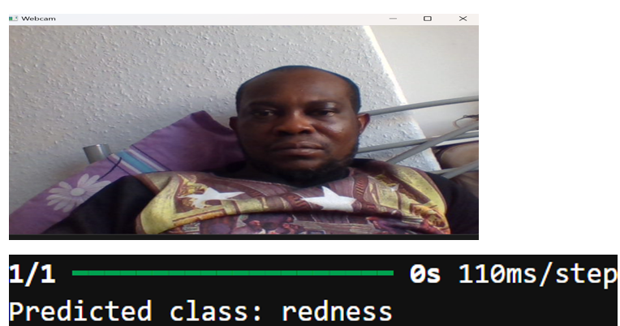
Example predictions and visualizations.
Prediction from Webcam:

Slide 14
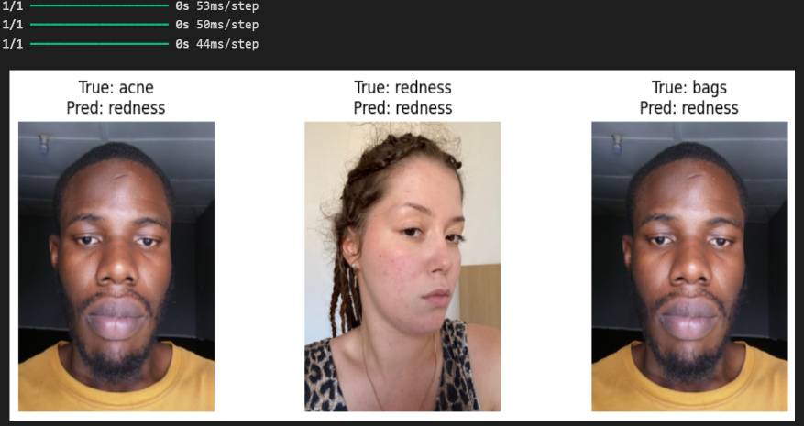
Visualization:
Sample images with their true labels and predictions were displayed.

Slide 15
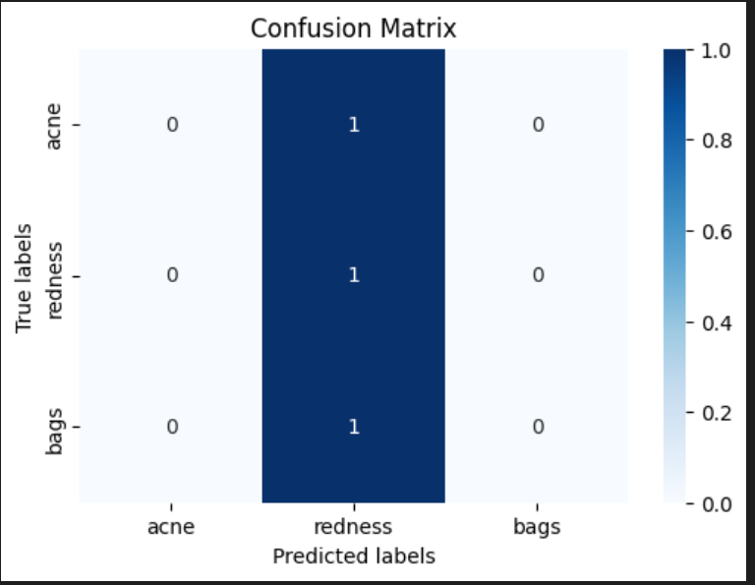
A confusion matrix was plotted
In the confusion matrix plot, the class labels are acne, redness, and bags. The diagonal of the confusion matrix shows the number of times that the model correctly predicted the class label. For example, the top left cell of the matrix shows that the model correctly predicted acne 1 times.
The off-diagonal cells of the confusion matrix show the number of times that the model predicted the wrong class label. For example, the cell in the second row and first column of the matrix shows that the model predicted acne 0 times for data points where the true label was redness.

Slide 16
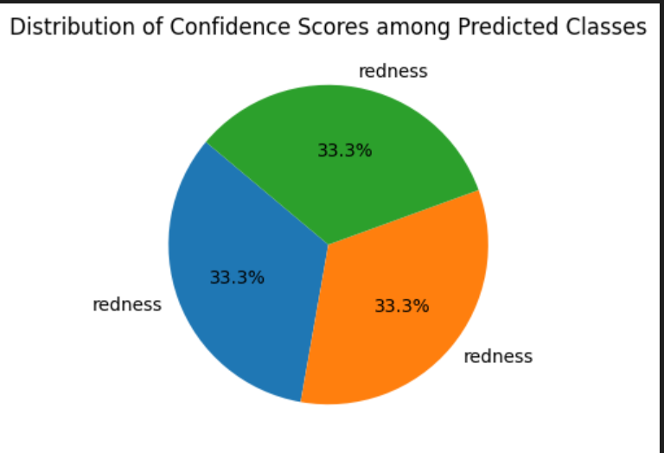
Confidence scores of predictions were plotted as pie charts.

Slide 17
Confidence scores of predictions were plotted as pie charts.
The pie chart above shows the distribution of confidence scores for a model that predicts the class label "redness." In other words, the pie chart slices represent different confidence levels the model has in predicting "redness" for a specific data point. It appears there are three confidence levels all at 33.3%.

Slide 18
Insights on model performance and areas of improvement.
Insights Gained
1. Importance of Data Augmentation
Data augmentation significantly improved the model's generalization ability by providing varied training samples.
2. Model Regularization
Applying dropout and using L2 regularization helped mitigate overfitting and improved model performance on the validation set.
3. Real-time Applications
Integrating the model with a webcam for real-time predictions demonstrated the practical applicability of the model in real-world scenarios.
4. Need for More Data
To improve the model's accuracy and reliability, a larger and more diverse dataset is essential. More data would help the model learn better and differentiate between similar classes like "acne," "redness," and "bags."
5. Visualization
Visualizing training progress, confusion matrices, and prediction confidence scores provided valuable insights into model performance and areas for improvement

Slide 19
Challenges and Limitations
Limited Dataset and Its Impact on Model Performance
Our dataset consisted of a relatively small number of images for each class (acne, redness, bags). This limited the model's ability to learn diverse features associated with each skin condition.
Impact on Model Performance:
The small dataset led to overfitting, where the model performed well on training data but struggled with new, unseen data.
The model tended to classify most images as 'redness,' indicating that it did not learn the distinguishing features of 'acne' and 'bags' effectively.
Data Augmentation as a Mitigation Strategy:
To address the limited dataset, we used data augmentation techniques such as rotation, shifting, zooming, and flipping. This helped in artificially increasing the dataset size and introducing more variability.
Limitations of Data Augmentation:
While data augmentation helped, it could not fully replace the need for a larger, more diverse dataset. The model's performance could significantly improve with more real images for training.

Slide 20
Other Technical Challenges Faced and How They Were Addressed
1. Class Imbalance:
Challenge: Our dataset had an imbalance in the number of images per class, with some classes being underrepresented.
Solution: We calculated and applied class weights to ensure that the model paid equal attention to all classes during training. This approach helped to mitigate bias towards the majority class.
2. Overfitting:
Challenge: The model showed signs of overfitting, performing well on the training set but poorly on the validation set.
Solution:
Implemented dropout layers with a 50% dropout rate to reduce overfitting by randomly dropping neurons during training.
Used early stopping to halt training when the validation loss stopped improving, preventing the model from over-learning the training data.

Slide 21
Other Technical Challenges Faced and How They Were Addressed
3. Computational Resources:
Challenge: Training deep learning models requires significant computational power and time.
Solution: Used efficient training techniques and optimized the model architecture to balance performance and computational efficiency. Leveraged cloud-based services when necessary to handle intensive computations.
4. Model Interpretability:
Challenge: Deep learning models, especially CNNs, are often seen as 'black boxes' and their decision-making processes are not easily interpretable.
Solution: Used visualization techniques such as plotting sample images with predictions and confidence scores to provide insights into the model's predictions. This helped in understanding which features the model focused on for its decisions.
By addressing these challenges, we aimed to improve the robustness and reliability of our skin disease classification model, though acknowledging that further improvements and a larger dataset would enhance the model's performance.

Slide 22
Future Work and Impact
Steps for Improving the Model
1. Acquiring More Data:
To significantly enhance the model's performance, acquiring a larger and more diverse dataset is crucial. This will help the model learn a wider range of features associated with each skin condition.
Methods:
Collaborating with dermatology clinics and hospitals to collect more patient images.
Utilizing publicly available medical image databases and crowdsourcing labeled data from certified dermatologists.
2. Enhancing Model Architecture:
Exploring more advanced deep learning architectures, such as transfer learning with pre-trained models like ResNet or EfficientNet, to improve feature extraction and classification accuracy.
Implementing advanced techniques like attention mechanisms to allow the model to focus on the most relevant parts of the images.
3. Improving Data Augmentation:
Using more sophisticated data augmentation techniques, including synthetic data generation and GANs (Generative Adversarial Networks), to further diversify the training data.

Slide 23
Future Work and Impact
4. Continuous Model Evaluation:
Setting up a continuous evaluation pipeline to regularly assess model performance with new data and update the model as needed.
Potential Impact on Clinical Practice and Patient Care
1. Enhanced Diagnostic Accuracy:
With improved models, dermatologists can achieve higher diagnostic accuracy, leading to better patient outcomes and more precise treatment plans.
Impact: Early and accurate detection of skin diseases can significantly reduce the progression of diseases and improve patient prognosis.
2. Streamlined Clinical Workflows:
Automated skin disease classification can reduce the workload of dermatologists, allowing them to focus on more complex cases and improving overall efficiency in clinical settings.

Slide 24
Future Work and Impact
3. Increased Accessibility:
Telemedicine applications powered by the model can provide remote diagnostic services, making dermatological care accessible to patients in underserved and remote areas.
4. Patient Education and Empowerment:
Mobile applications utilizing the model can help patients monitor their skin conditions, adhere to treatment plans, and seek medical advice promptly, leading to better health outcomes.
Opportunities for Collaboration and Funding
1. Collaboration with Medical Institutions:
Partnering with hospitals, clinics, and research institutions to collect data, validate the model, and conduct clinical trials.
Benefits: These collaborations can provide access to high-quality data, clinical expertise, and practical insights to refine the model.
2. Academic and Industry Partnerships:
Engaging with academic researchers and industry experts to explore innovative methodologies and technologies for model improvement.

Slide 25
Future Work and Impact
3. Funding Opportunities:
Applying for grants from medical research foundations, government health agencies, and technology funding programs to support the development and deployment of the model.
Seeking investment from private sector companies in the healthcare and technology industries interested in AI-driven healthcare solutions.
By focusing on these future steps and leveraging collaboration and funding opportunities, the project aims to make a substantial impact on the field of dermatology, improving both clinical practice and patient care outcomes

Slide 26
Conclusion
In conclusion, the development of this deep learning project for skin disease classification from facial images addresses the critical need for accurate and automated diagnostic tools. By leveraging state-of-the-art techniques in deep learning and computer vision, significant steps have been taken towards creating a model that can enhance diagnostic accuracy and improve patient care. Despite the challenges faced, particularly the limited dataset which impacted the model's ability to differentiate accurately between conditions like acne, redness, and bags, the project demonstrates the potential for significant advancements in dermatological diagnostics.
Overall, this project lays the groundwork for future research and development in automated skin disease classification, with the ultimate goal of improving healthcare outcomes and advancing the field of dermatology.

